Slide 1

Clustering Music from Spotify
By Christopher Clegg
ece.clegg@gmail.com

Slide 2
Why cluster music data?
The motivation:
Practice my new data science skills, see if genres can be grouped with a ML model
Interesting, important, and worth knowing
The data:
Music: Data for 170K+ songs from Spotify
Music Descripters: Acousticness, speechiness, liveness, instumentalness, energy, loudness, key, mode, etc.

Slide 3

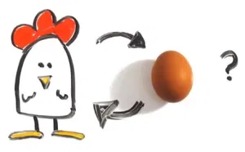
I’m open to suggestions!
Did the critics review boost sales, or did the critic’s review come after the boosted sales?
Picture Source: https://shadybeach.org/suggestion-box/

Slide 4
How important is a good recommendation? “Judging by Amazon’s success, the recommendation system works. The company reported a 29% sales increase to $12.83 billion during its second fiscal quarter, up from $9.9 billion during the same time last year. A lot of that growth arguably has to do with the way Amazon has integrated recommendations into nearly every part of the purchasing process…”
Source: https://rejoiner.com/resources/amazon-recommendations-secret-selling-online/

Slide 5
How well does this data cluster?
What data is used? What other data could be used?

Slide 6
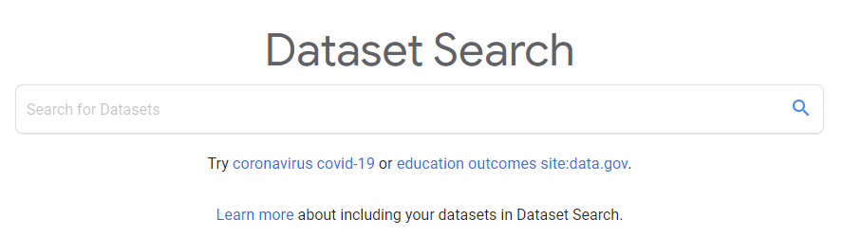
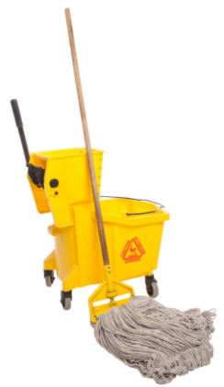

Research: A brief “play-by-play”
Search for data
Found some open-source data at Kaggle.com provided by Yamac Eren Ay using the Spotify API
Exploring and Cleaning
Data rarely comes in ideal shape and never comes conveniently pre-arranged just for you.
What to do about missing data?
Drop it or fill it in?
Preparation for the model.
Encoding, and scaling.

Slide 7

Research: A brief “play-by-play” cont’d...
Getting a feel for the data
Preliminary visualization:
Distributions
Scatterplots
What Tools Should I Use?
Determine models to use
Which model best fits the goal of this project.

Slide 8

Research: A brief “play-by-play” cont’d...
Apply clustering methods
Tuning Parameters
Visualize the results, incorporate them into an explanation that is relatable, and form a final conclusion.
Picture Source: https://www.123rf.com/photo_124220354_stock-vector-finish-banner-symbol-of-championship-successful-racing-symbol-finish-line-flat-design-eps-10-.html

Slide 9
My methods
K-Means Clustering
Gaussian Mixture Clustering
DBSCAN
These are the method I chose, and why I chose them.

Slide 10
My methods
Dimensionality Reduction
PCA
UMAP
Number of Principle Components/clusters
Elbow Method
Observe Cluster Characteristics
Cluster_centers/means
Gradient talbe
These are the method I chose, and why I chose them.

Slide 11
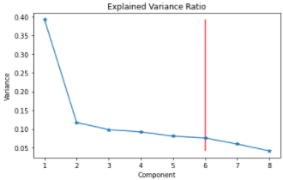
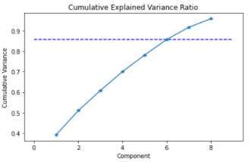
Evaluating Dimensional Reduction
Method to determine the number of components to use in dimension reduction with PCA
Not a very sharp elbow
Needed at least 6 components to top 80% of variance explained
Figure 1. Explained Variance Ratio per cluster (top). Cumulative Explian Variance Ratio per additional cluster (bottom).

Slide 12
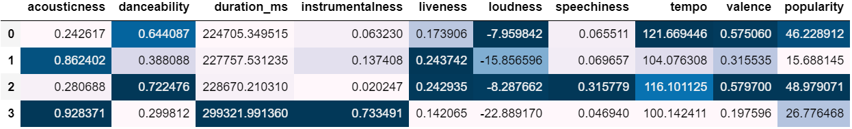
K-Means Clustering
Cluster zero:
High danceability, loudness and popularity
Low acoustic and speechiness
Possibly Show Tunes
Cluster one:
High acoustics and liveness
Low danceability and loudness
Possibly Country
Cluster two:
High danceability and energy
Low popularity and acoustics
Possibly Rap/Hip-Hop/Pop
Cluster three:
High acoustics, duration, and instrumentals
Low danceability
Possibly Classical
Parameters:
Number of clusters: 4
Silhouette Score:
3 clusters: 0.2481
4 clusters: 0.2170
5 clusters: 0.1901
Figure 2. k-means cluster characteristics

Slide 13
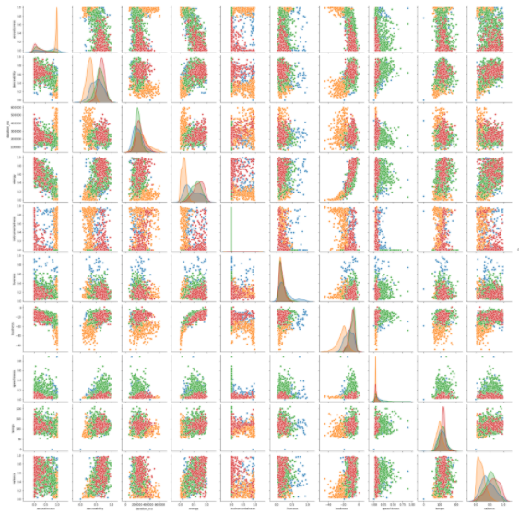
Cluster zero:
High danceability, energy and popularity
Low acoustic and instrumental
Possibly Rap/pop
Cluster one:
High acoustics
Low danceability and energy
Possibly Country
Cluster two:
High danceability and energy
Low popularity and acoustics
Possibly Show Tunes
Cluster three:
High acoustics and instrumentals
Low danceability and energy
Possibly Classical
Figure 3: Pair plot with K-Means Clustering

Slide 14
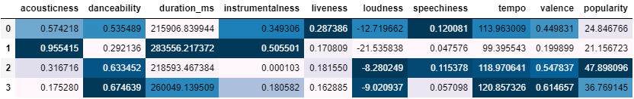
Guassian Mixture Clustering
Cluster zero:
High danceability, energy
Low acoustic and slightly lower instrumental
Possibly Show Tunes
Cluster one:
High acoustics
Low danceability and energy
Possibly Country Music
Cluster two:
High danceability, energy, and popularity
Low acoustics and instrumental
Possibly Rap/Pop
Cluster three:
High acoustics and instrumentals
Low energy and danceability
Possibly Classical
Parameters:
Number of clusters: 4
metrics: Euclidean
Silhouette Score:
3 clusters: 0.1664
4 clusters: 0.1440
5 clusters: 0.0620
Figure 4. GMM cluster characteristics

Slide 15
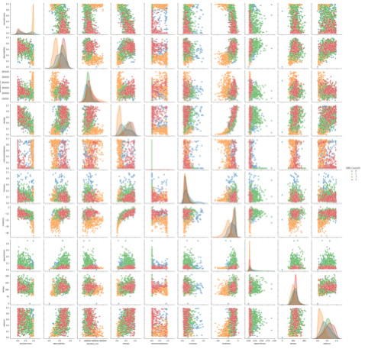
Cluster zero:
High danceability, energy and popularity
Low acoustic and instrumental
Possibly Rap/pop
Cluster one:
High acoustics
Low danceability and energy
Possibly Country
Cluster two:
High danceability and energy
Low popularity and acoustics
Possibly Show Tunes
Cluster three:
High acoustics and instrumentals
Low danceability and energy
Possibly Classical
Figure 5: pair plot with GMM clustering

Slide 16
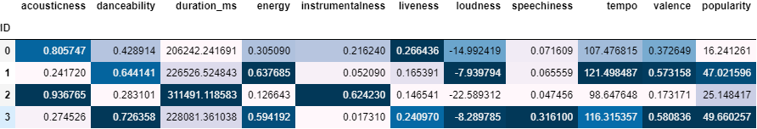
PCA Reduced, K-Means Clustered
Cluster zero:
High acoustics, danceability and liveness
Low acoustic and slightly lower instrumental
Possibly Country
Cluster one:
High danceability, energy, loudness, tempo
Low speechiness and instrumentalness
Possibly Pop
Cluster two:
Low danceability, energy, and popularity
High acoustics, duration, and instrumental
Possibly Classical
Cluster three:
Low acoustics and instrumentals
High energy, danceability, and speechiness
Possibly Rap/Hip-Hop/Pop
Parameters:
Number of clusters: 4
metrics: Euclidean
Silhouette Score:
3 clusters: 0.3673
4 clusters: 0.2973
5 clusters: 0.2519
Figure 6. PCA – K-means cluster characteristics

Slide 17
UMAP Reduced, K-Means Clustered
Cluster zero:
High acoustics, danceability and liveness
Low acoustic and slightly lower instrumental
Possibly Country
Cluster one:
High danceability, energy, loudness, tempo
Low speechiness and instrumentalness
Possibly Pop
Cluster two:
Low danceability, energy, and popularity
High acoustics, duration, and instrumental
Possibly Classical
Cluster three:
Low acoustics and instrumentals
High energy, danceability, and speechiness
Possibly Rap/Hip-Hop/Pop
Parameters:
Number of clusters: 4
metrics: Euclidean
Silhouette Score:
3 clusters: 0.6202
4 clusters: 0.4259
5 clusters: 0.4057
Figure 7. UMAP – K-means cluster characteristics

Slide 18
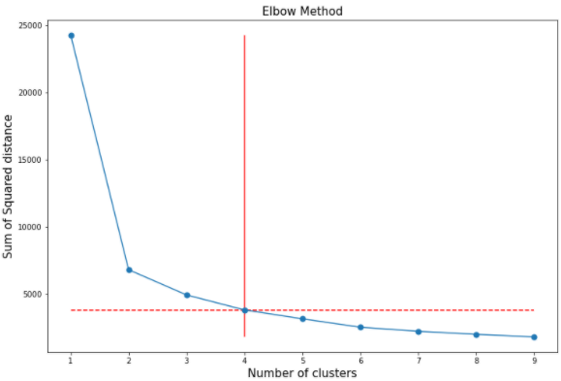
This was produced from the UMAP reduced, K-means algorithm
Chose to go with four clusters
This brings the SSD below 5000
Figure 7: Determining number of clusters via elbow method

Slide 19
Where to go from here? Improved data sets with better genre classification Use this to generate suggestions

Slide 20
The End
Questions?

